Slide 1

THE SPEECH ACT OF CONGRATULATING IN THE MACEDONIAN DIGITAL LANGUAGE
Presented by
Marija Grkova-Beader and Ana Koceva

Slide 2
Introduction
Speech acts are influential linguistic forms that are part of everyday communication whether it is in spoken or written form.
They are both derived from the context and simultaneously create the context itself.
The context represents a collection of statements used to describe our beliefs, knowledge and attentiveness toward the participants in the discourse.

Slide 3
“the speech act of congratulating is part of the expressives, which aim to point toward the psychological condition of the speaker.”
– Ramadani, 2024

Slide 4
Assertives | Directives | Commisives | Expressives | Declaratives
Statement | Request | Promise | Expressing emotion | Christening
Notification | Prohibition | Guarantee | Giving a blessing | Wedding
Informing | Appeal | Offer | Giving and responding to a compliment | Judging
Expressing a view | Permission | Acceptance | Expressing condolences | Military reviews
Insisting | Plea | Taking an oath | Regret and condemnation | Dismissal
Response | Order | Threat | (Dis)agreement | Appointment
Description | Offer | Rejection | Thanking | Betting
Denial | Invitation |  | Apology | Decisions of commissions/juries
Confirmation | Encouragement |  | Swearing | Openings of new facilities
Suggestion | Propositon |  | Greeting
Prediction | Warning |  | Praise
Confession | Advise |  | Congratulating
Announcement | Suggestion
Claim

Slide 5
According to literature
Brown & Levinson (1987) also explain that congratulations are most frequently used to strengthen the positive face of the speaker in order to express solidarity and approval, which in a way means a recognition of the success of the speaker.
However, it has to be taken into consideration that in certain situations, congratulations are expressed with a different intention, or are used in a sarcastic manner.

Slide 6
Methodological framework
The subject of analysis in this research paper is the speech act of congratulating in written digital communication on the social network “Facebook”.
Classification by Elwood
(as cited in Aziz, 2004, p.3)
No. | Type of strategy
1 | Illocutionary force indicating device (IFID)
2 | Expression of happiness
3 | An offer of good wishes
4 | Request for information
5 | Asking for sweets
6 | Self-related comments: an expression of envy and longing
7 | Joking
8 | Thanking God
9 | Encouraging

Slide 7
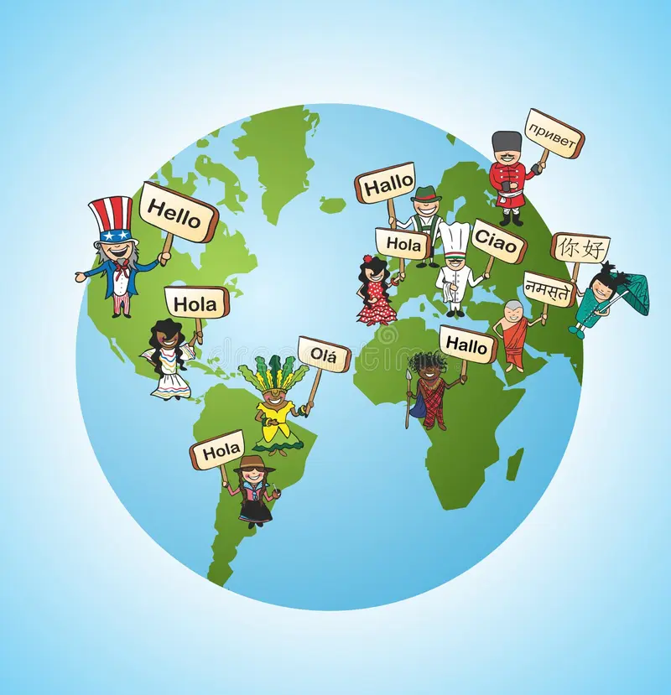
Results
Results show that congratulating is often expressed through a combination of a direct congratulation followed by compliments, blessings or comments that show support. Also, congratulations appear in a combination with emoticons, likes and other visual elements that strengthen and intensify the act itself.
Graph 1 represents the results from the analysis of a public post about an announcement about a gained award by a Macedonian singer, which was shared on his personal profile. The post features a photo of the received statuette and the recognition titled “Pop performer of the year”. The post has 105 comments. As presented in graph 1 (next slide), it is visible that the most frequent strategies are the following: IFIDs, compliments, personal comments, encouragements; while as modifiers we have detected: stickers, emoticons and GIFs.

Slide 8
Graph 1engaged through effective techniques

Slide 9
The second graph presents the results from the analysis of a personal post about a 9-year anniversary shared by a Macedonian reporter and presenter with a photo of the pair. This post, which was again shared on a personal profile as a public post, was followed by 293 comments. Graph 2 clearly shows that additional elements in the form of stickers, emoticons and GIFs prevail in the comments, while from the linguistic forms the most frequent are the strategies of expressing good wishes, giving compliments, IFIDs and encouragements.

Slide 10
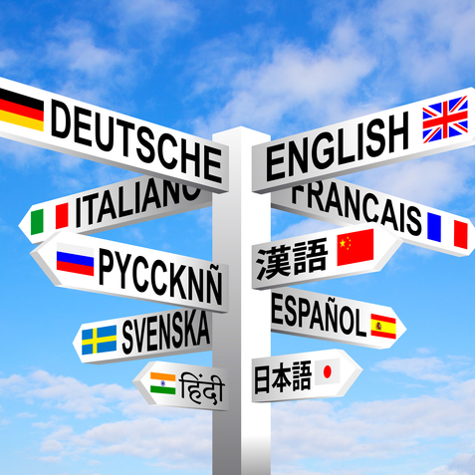
Graph 2: Celebrating an anniversary

Slide 11
Graph 3 presents the results from a post about a new song with a music video by Macedonian singers, which was followed by 96 comments. Here the strategies that prevail are the IFIDs, the compliments, personal comments and encouragements, while in the role as modifiers appear again stickers and GIFs.

Slide 12
Analysis & Discussion

Slide 13
The analysis of the congratulations, which appear as a response speech act to three different public posts on a digital social medium, reveals similar pragmatic parameters, but different linguistic variations in Macedonian written communication.
All three posts cause a commentary response in the form of a positive and expressive speech act that is formulated in accordance of the shared post.

Slide 14
The main characteristic...
The obtained shows that congratulations are expressed through a direct act in the form of an explicit phrase such as: “Честитки” [Congratulations], “Браво” [Bravo] and similar forms that are generally known as congratulatory phrases.
The most frequent strategy in two of the posts are the illocutionary indicating devices, which very clearly express the communicative intention of the congratulation and represent a central element in the speech act.

Slide 15
An interesting fact is that in the obtained data the use of the elements such as stickers and GIFs often appear as an individual way of congratulating, especially in the second post. These elements enable the users of the social network to express their emotional feeling of happiness for another person without relying on any textual phrases, which overlaps with notions from other research (McCulloch, 2019., Tolins & Samermit 2016).

Slide 16
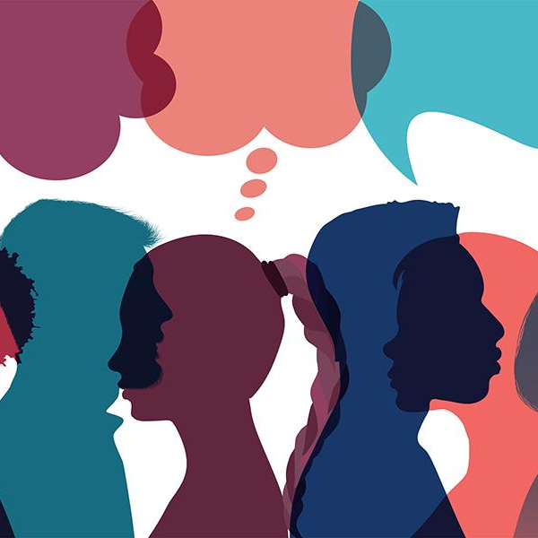
Congratulating on social media has been determined not only as a linguistic act, but also as a complex social act moulded by the identity of the public and the nature of the event. The combination of a central congratulation with an additional comment and other visual elements that intensify the act itself, show that the digital discourse becomes more and more dependent on the visual resources are not elective or possible additions, but basic components that create meaning and maintain the general trends described in research of multimodal interaction (Jewitt, 2016).

Slide 17
Conclusion
This paper represents an analysis of the speech act of congratulating focusing on public posts on the social network Facebook in three different contexts. The analysis showed that the preferred form of Macedonian speakers is a direct congratulatory act that is further intensified through added visual elements. A dominant strategy are the illocutionary force indicating devices in the public posts of the singers, while the visual elements and the expressions of good wishes are more frequent in the post of the reporter. Hence, it can be concluded that the linguistic and multimodal forms of congratulating are highly modified by the nature of the event and the social status between the person that publishes the post and the audience or the people that comment. This paper contributes toward the understanding of how the traditional categories of speech acts are adjusted in the digital environment, where the visual elements are gradually taking more central role in all types of utterances.

Slide 18
References
Austin, J. L. (1962). How to do things with words. Oxford University Press.
Aziz, R. N. (2024). Congratulation Strategies: Pragmatic Study. British Journal of English Linguistics, 12(1), 1–8. https://doi.org/10.37745/bjel.2013/vol12n118
Brown, P. & Levinson, S. (1987) Politeness. Some universals in language usage. Cambridge: Cambridge University Press.
Baym, N. (2018). Playing to the crowd: Musicians, audiences, and the intimate work of connection. NYU Press.
Click, M., & Scott, S. (2018). Making fans: Literacy, affect, and participatory culture. University of Michigan Press.
Darics, E. (2013). Non-verbal signalling in digital discourse: The case of letter repetition. Discourse, Context & Media, 2(3), 141–148.
Elwood, K. (2004). Congratulations: A cross-cultural analysis of responses to another’s happy news. Journal of Pragmatics, 36(5), 1017–1040. https://doi.org/10.1016/j.pragma.2003.10.006
Herring, S. C. (2013). Discourse in Web 2.0: Familiar, reconfigured, and emergent. Georgetown University Press.
Jewitt, C. (2016). The Routledge handbook of multimodal analysis (2nd ed.). Routledge.
Kusevska, M. (2016). “Framework of intercultural research of speech acts” [Рамка за меѓукултурните истражувања на говорните чинови]. Our language today. Proceedings of the scientific conference "The Linguistic Picture of the World". Volume: 26. pp. 119-128.
McCulloch, G. (2019). Because Internet: Understanding the new rules of language. Riverhead Books.
Page, R. (2014). Narratives online: Shared stories in social media. Cambridge University Press.
Ramadani, N.M. (2024). The use of speech acts among Albanians in Republic North Macedonia (apologies and promises). PhD paper. Skopje, University “Ss. Cyril and Methodius”, Faculty of Philology “Blazhe Koneski”
Searle, J. (1969). Speech acts: An essay in the philosophy of language. Cambridge University Press.
Tolins, J., & Samermit, P. (2016). GIFs as embodied enactments: Using GIFs to communicate emotion. Proceedings of the ACM on Human-Computer Interaction, 1.
Vinca, E. (2021). Analysis of interpersonal discourse markers in Macedonian and Albanian spoken language in comparison with English [Анализа на интерперсоналните дискурсни маркери во македонскиот и во албанскиот говорен јазик во споредба со англискиот]. Doctoral thesis. Skopje, University “Ss. Cyril and Methodius”, Faculty of Philology “Blazhe Koneski”
Xia, D., Yin, C., & Lan, C. (2021). Article in Translation: Chinese compliment responses in triadic contexts. Journal of Pragmatics, 174, 117–124. https://doi.org/10.1016/j.pragma.2020.10.009.

Slide 19
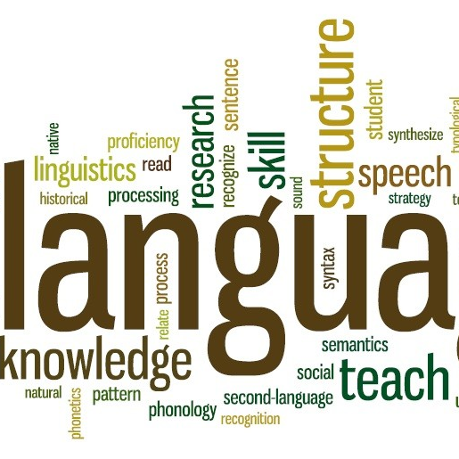
Thank you!

